Slide 1
Discovering the Need for React

Slide 2

Pretest
What is declarative programming?
What are React components? What is the Virtual DOM?

Slide 3
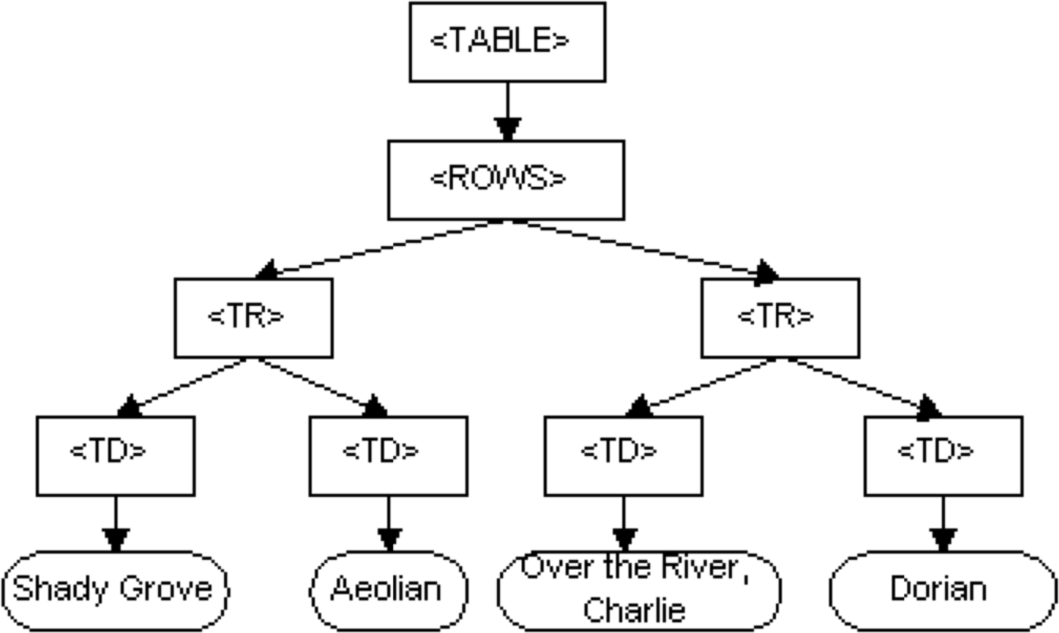
What Is the DOM?
Programming API for Web Pages
Enables Dynamic Web Pages Exposes Methods and Properties

Slide 4
<div id="userName"></div>
<script>
document.getElementById("userName").innerHTML = "Chris";
</script>
Pure JavaScript DOM Manipulation

Slide 5
<div id="userName"></div>
<script>
$('#userName').html("Chris");
</script>
jQuery DOM Manipulation

Slide 6
<div ng-app="myApp" ng-controller="myCtrl">
<p ng-bind-html="myText"></p>
</div>
<script>
app.controller('MainCtrl', function($scope) {
$scope.content = "Chris";
});
</script>
Angular DOM Manipulation

Slide 7


Imperative vs. Declarative
Imperative Start at the dot. Walk to the lake.
Turn right and continue for 5 km.
Turn left and walk 2 km.
Declarative
Go to the 'x'.

Slide 8
<div id="app"></div>
<script>
class UserInfo extends React.Component({ render() {
return (
<p>{this.props.userName}</p>
);
}
});
ReactDOM.render(<UserInfo userName="Chris" />, document.getElementById('app'));
</script>
React DOM Manipulation

Slide 9

React Elements
const element = React.createElement("tr",null,
React.createElement("td",null,"data"), React.createElement("td",null,"data")
);
ReactDOM.render(element, document.getElementById('app'));

Slide 10
React.Component
class MyComponent extends React.Component {
render() {
return ();
}
}

Slide 11
React.Component
class TableRow extends React.Component {
render() {
return React.createElement("tr",null, React.createElement("td",null,"data"), React.createElement("td",null,"data")
);
}
}

Slide 12
class TableRow extends React.Component {
render() {
return (<tr><td></td><td></td></tr>);
}
reactDOM.render(<TableRow>,document.getElementById('app'));
Output: <tr><td></td><td></td></tr>

Slide 13
class MyTable extends React.Component {
render() {
return (<table><TableRow><TableRow><TableRow></table>);
}
reactDOM.render(<MyTable>,document.getElementById('app'));
<table>
<tr><td></td><td></td></tr>
<tr><td></td><td></td></tr>
<tr><td></td><td></td></tr>
</table>

Slide 14




















React Data Flow
Component
Component
Component
Component
Data
Component
Component
Component
Component

Slide 15
reactDOM.render(<TableRow>,document.getElementById('app'));
Output
<tr>
<td>data</td>
<td>data</td>
</tr>

Slide 16
Virtual DOM
An Abstraction of the Browser DOM
React Holds Two Virtual DOMs React Optimizes DOM Updates

Slide 17
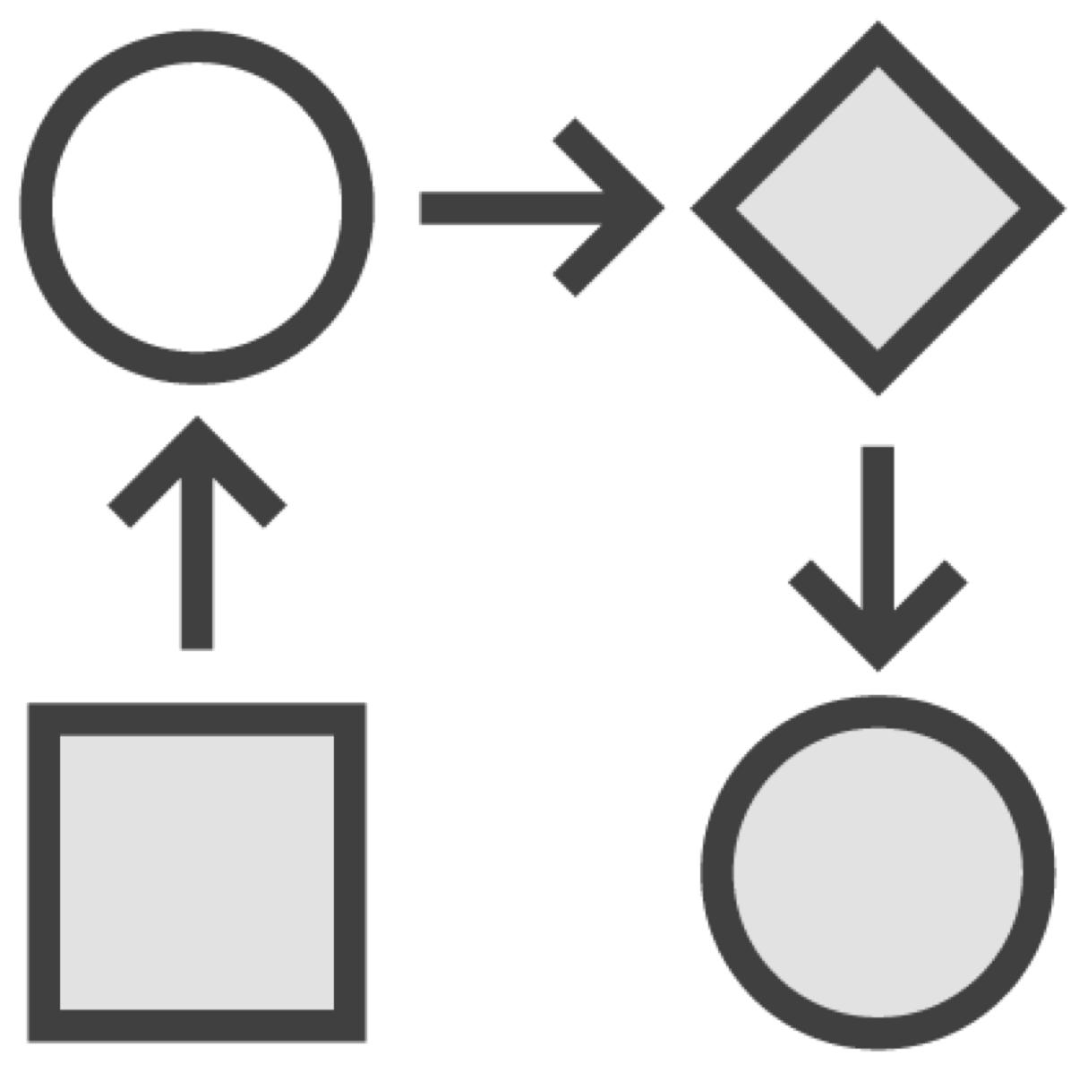
React Development Process
Create a Component Hierarchy
Build a Static Version Identify the Minimal UI State
Identify Where State Should Live Add Inverse Data Flow

Slide 18
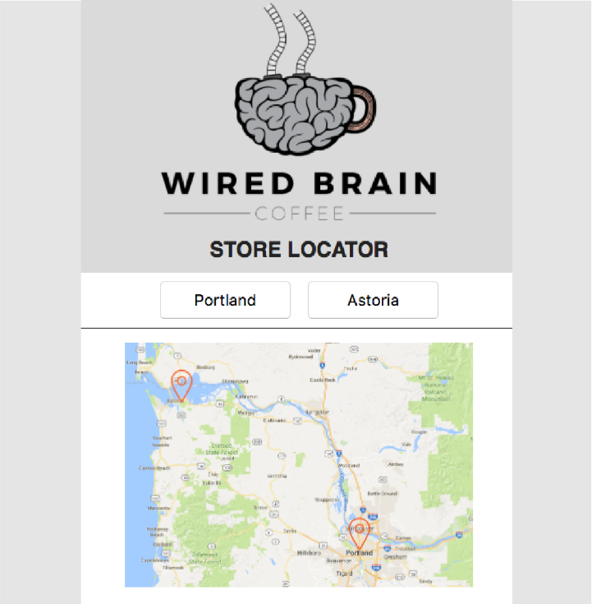
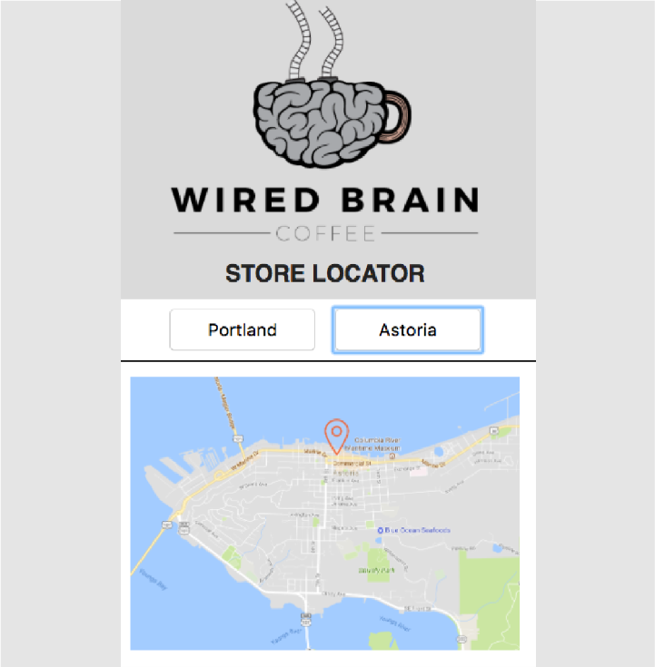
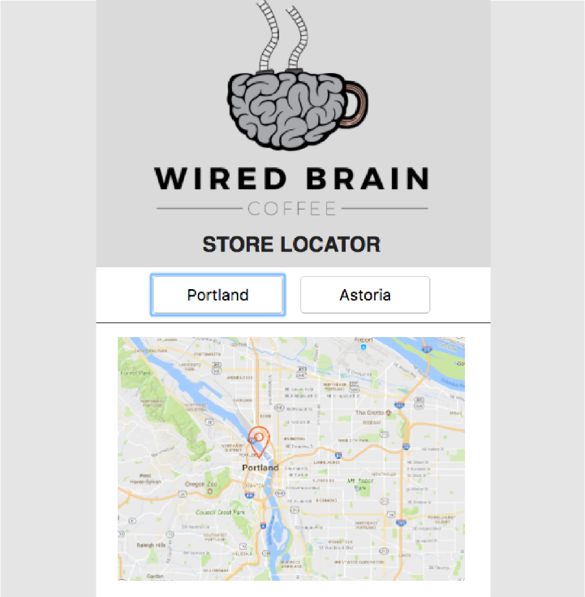
Prototype v2.0

Slide 19
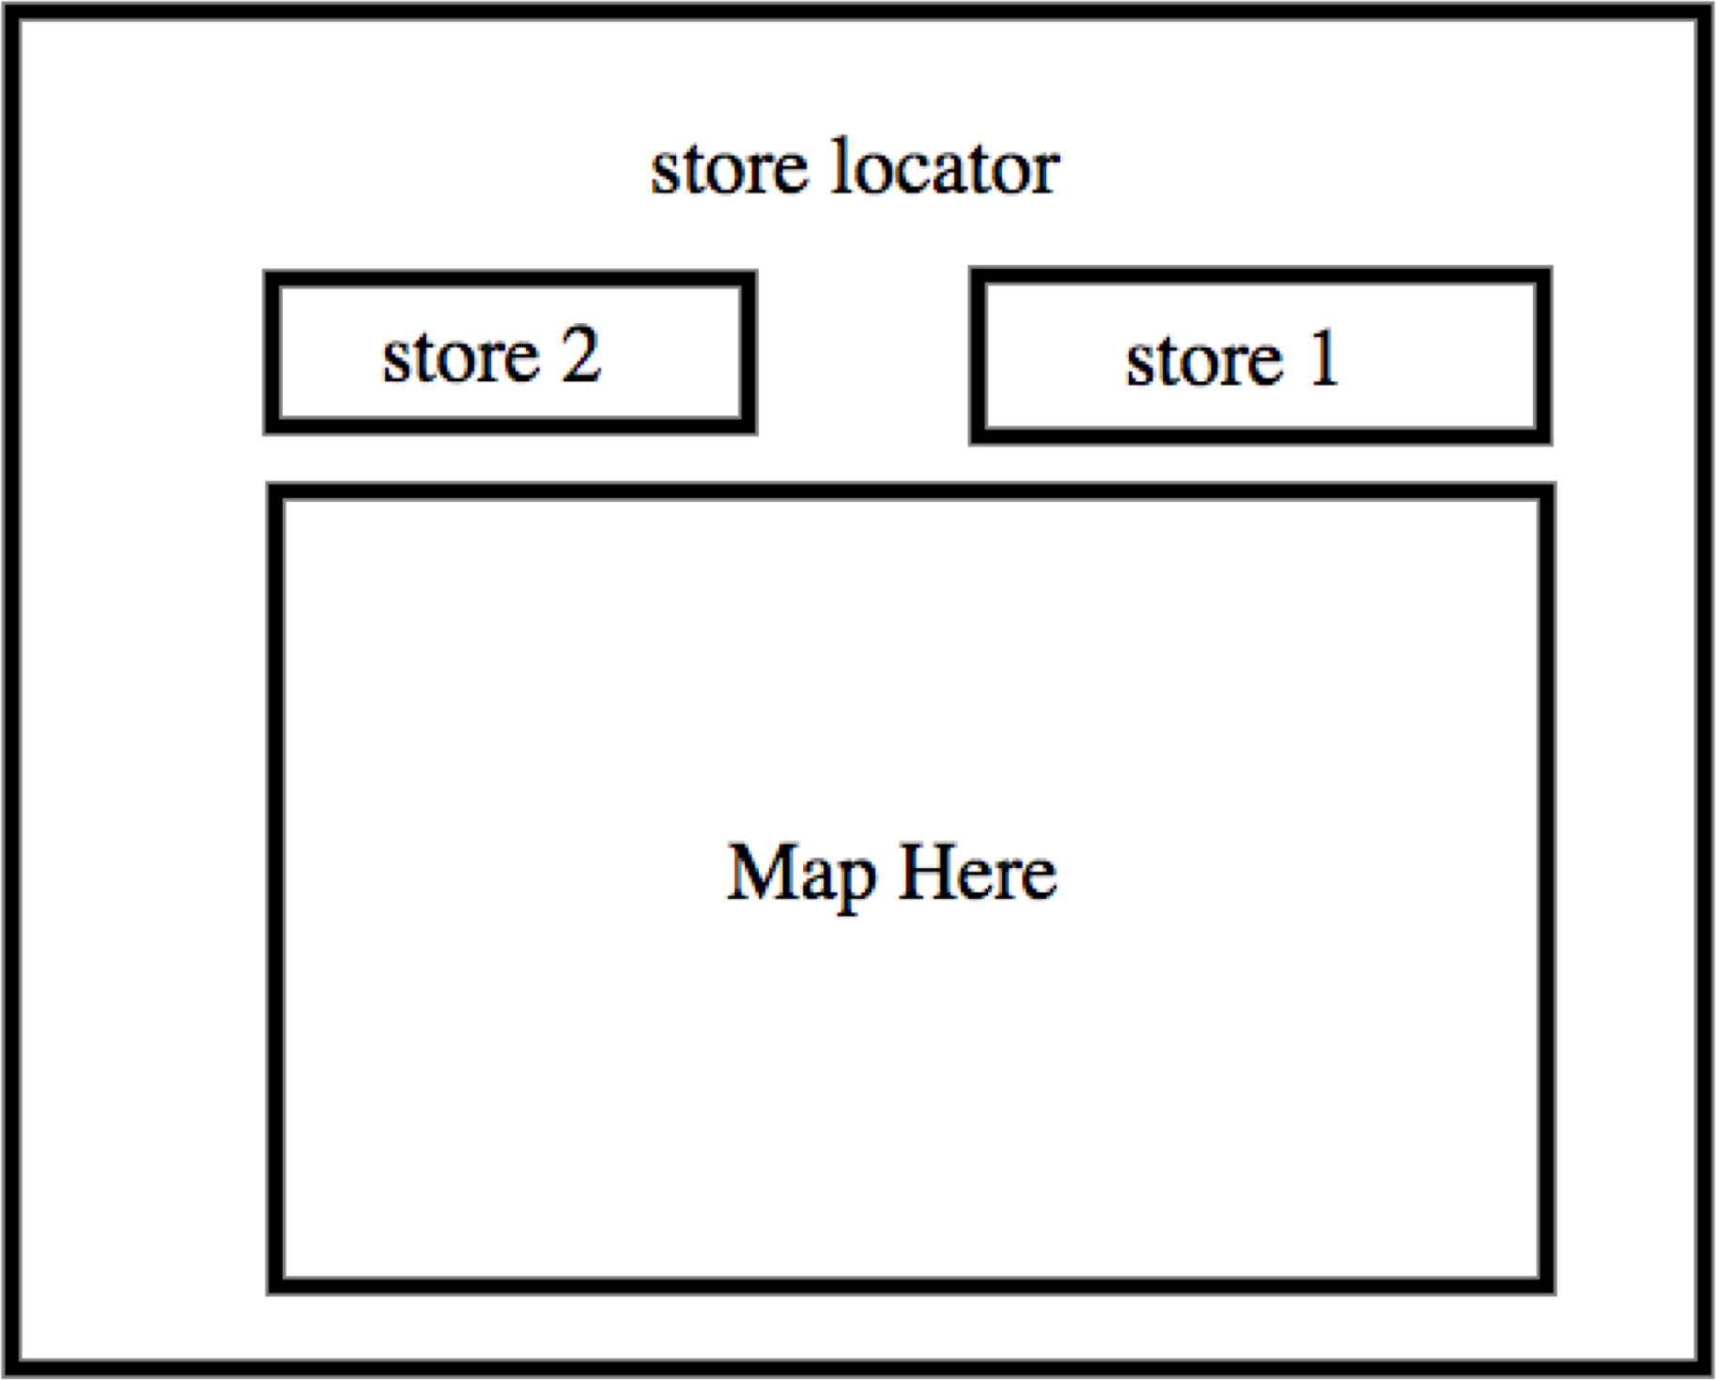
Break Up the UI

Slide 20

Demo
Building It up with Components

Slide 21
Demo
Passing Data Between Components

Slide 22
Components return elements
Elements describe output ReactDOM renders elements
Summary
Virtual DOM updates the browser DOM

Slide 23
Refactoring with React
COMING UP NEXT

